Slide 1
ME 504 PROJECT NUMERICAL MODELING OF GRANULAR SALT
BRANDON LAMPE
LAXMI PANERU
MAY 6th , 2015

Slide 2
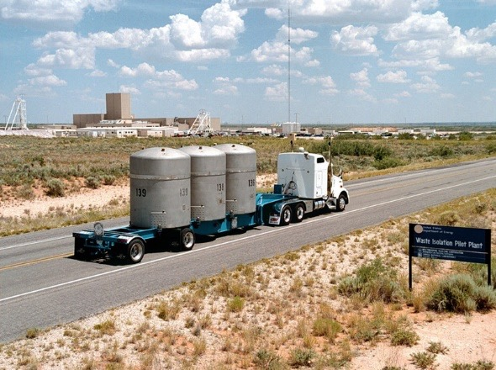
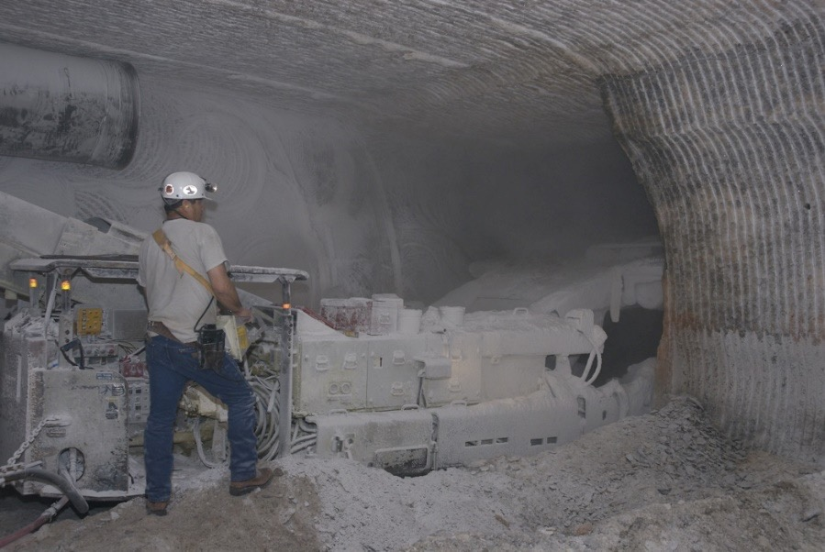
Fig 1: Nuclear waste being transported to WIPP facility for safe disposal.
INTRODUCTION
Crushed salt has been proposed for sealing the Waste Isolation Pilot Plant’s (WIPP) shafts, drifts, and boreholes
Intrinsic permeability of crushed salt has been observed to decrease with volumetric strain
OBJECTIVE
Determine if a FE model in Abaqus can capture the deformation measured in a laboratory experiment
Fig 2: Salt as a medium of nuclear waste disposal in repository.

Slide 3
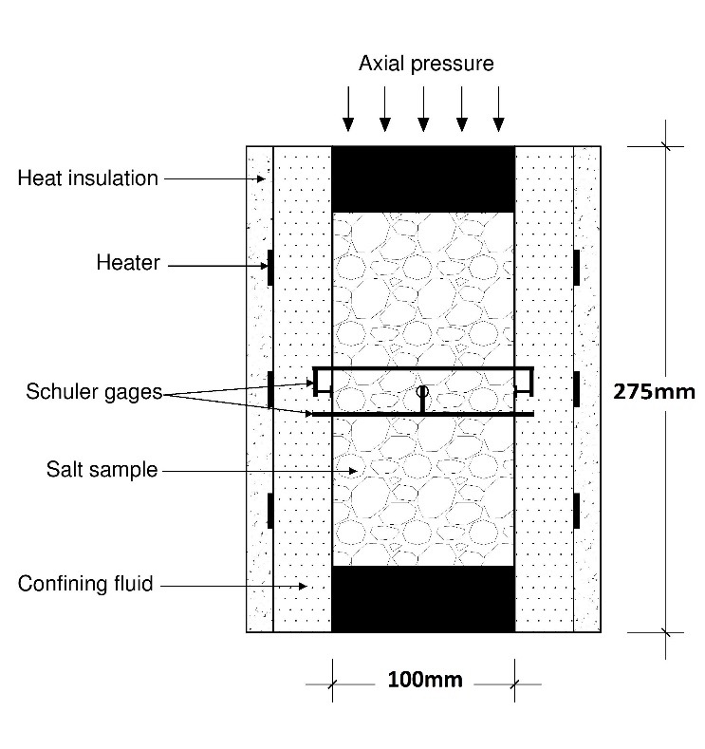
EXPERIMENTAL SETUP / SIMULATED PROBLEM
Specimen was subjected to a 20 MPa of hydrostatic pressure
Axial deformation was measured by linear variable differential transformers (LVDTs)
Lateral deformation was measured by a pair of Schuler gages
Volumetric strain was measured directly with a dilatometer and indirectly via axial and lateral deformation

Slide 4
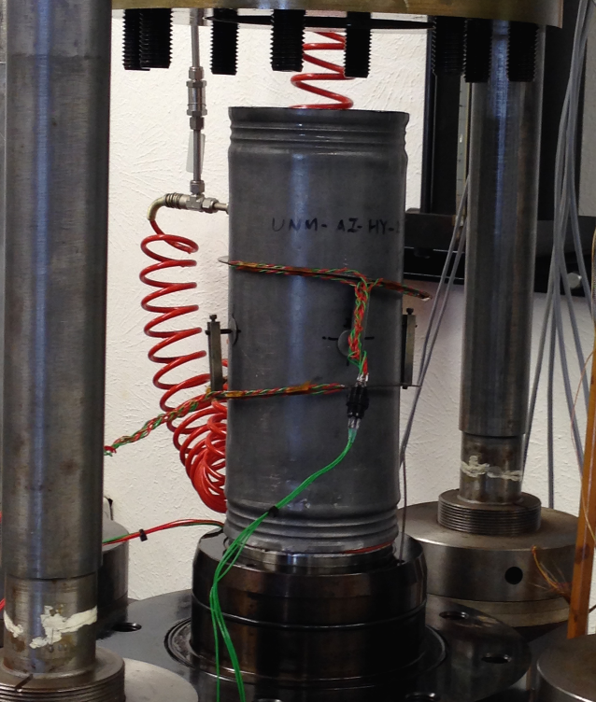
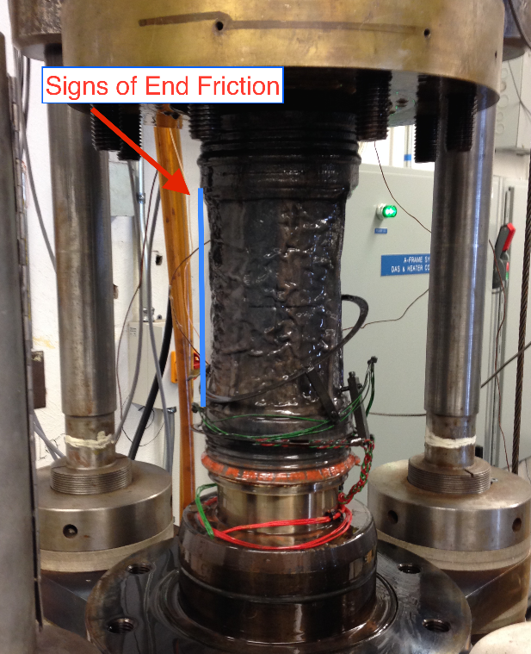
OBSERVED DEFORMATION
Pre Test
Post Test

Slide 5
CONSTITUTIVE MODELS
Simulations of time dependent deformation at a constant stress (creep) were performed using the following constitutive models.
Linear isotropic viscoelasticity
Nonlinear isotropic viscoplasticity (CS Model)
These models predict time dependent deformation
Isotropic elastic parameters were:
Young’s modulus = 5.6 GPa
Poission’s ratio = -0.75

Slide 6

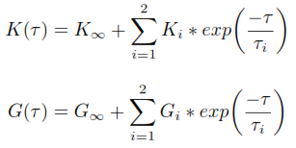

LINEAR ISOTROPIC VISCOELASTIC MODEL
The integral form of equation for linear isotropic viscoelastic material under hydrostatic stress utilized by Abaqus:
The relaxation functions, K(τ) and G(τ) were defined in terms of Proney series as:
Hydrostatic data only
The Proney series parameters:
Executed using FEM

Slide 7

CS MODEL
The CS Model assumes the operative deformation mechanisms in crushed salt are:
Dislocation creep
Pressure solutioning
Equivalent Stress (function of fractional density)
Nonassociative flow rule
The 13 parameters in CS Model were fit using Markov Chain Monte Carlo (MCMC) method, performed in R programming language
Executed using a driver program
Does not solve field equations – only the constitutive model

Slide 8
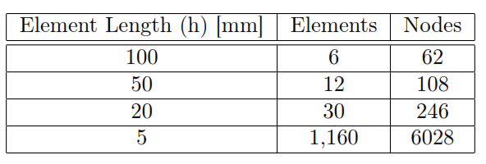
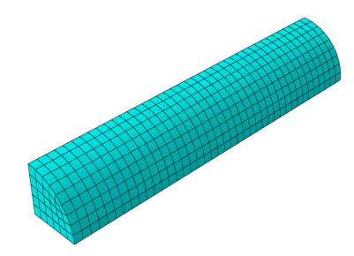
FINITE ELEMENT MODELING
Abaqus/CAE
linear isotropic viscoelastic constitutive model.
8- node brick elements
Convergence Study
Simulations were run with four difference discretizations
Aluminum end platens: Linear elastic
Specimen: Linearly viscoelastic material
Boundary conditions:
Upper platen: no displacement in z direction
Lower platen: prescribed stress
Curved face: prescribed stress
Planes of symmetry: no radial displacement
Finite element discretization for h= 5mm.

Slide 9
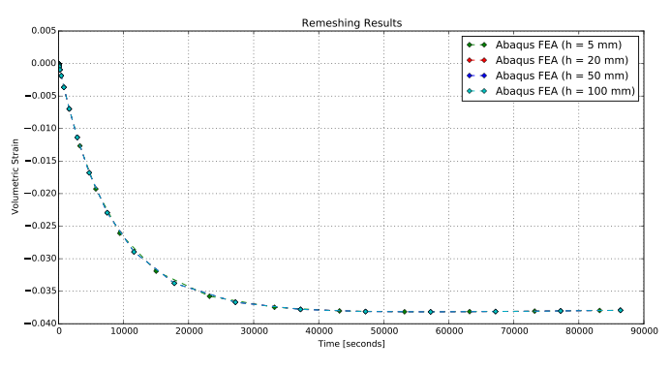
CONVERGENCE STUDY RESULTS
Results from a unique nodal point :
Results varied by 10⁻⁶
Largest variation observed at times less than 3*10⁴ seconds

Slide 10
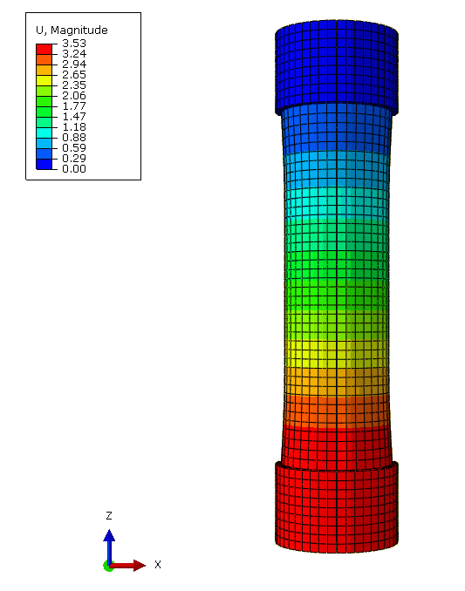
FEM RESULTS
Volumetric creep strain values (along the major principal axes) were obtained at a unique nodal point at the center of the specimen.
Displacement occurred in both the radial and axial direction during the test.
Deformation magnitude in the sample.

Slide 11
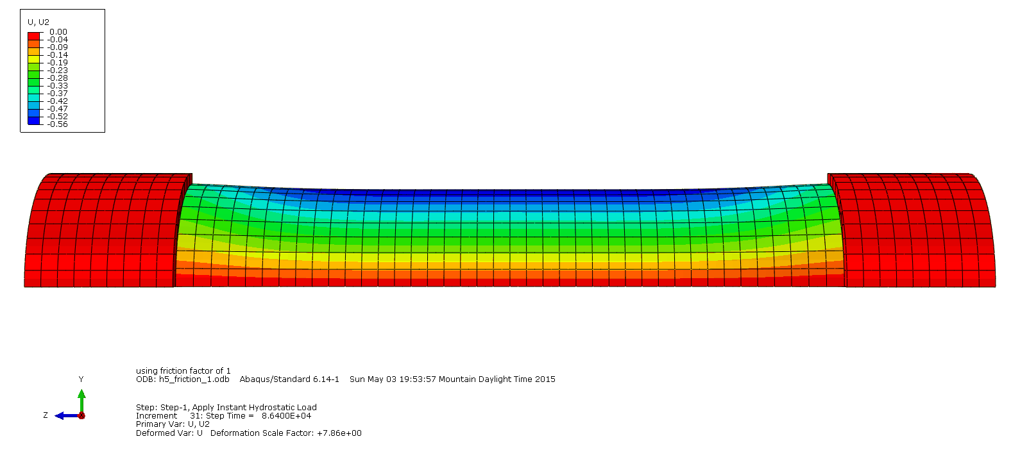
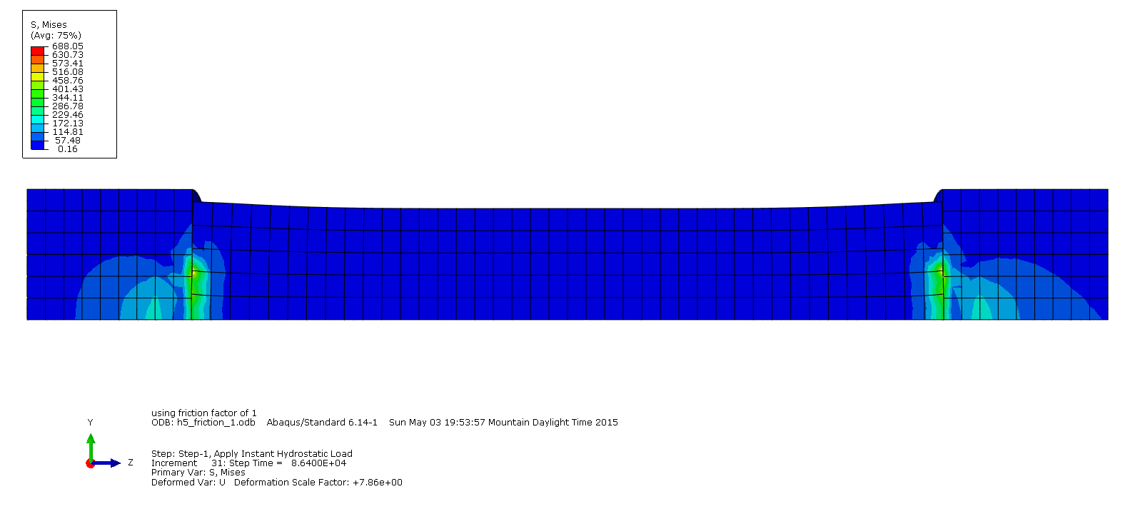
INFLUENCE FROM END FRICTION
Mises Stress (J2)
Radial Displacement.

Slide 12
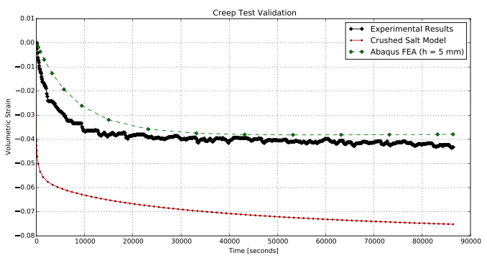
Validation of Numerical Results
CS Model
Fit to large database of both shear and hydrostatic test
Over predicts early deformation
Abaqus Model
Fit only to this exact creep test
Under predicts early deformation

Slide 13
CONCLUSIONS
Convergence study
very little deviation between discretizations were observed, which is likely a result of the problem definition, that being a hydrostatic stress applied to an isotropic material.
Influence of end friction
captured by the FE model, which is apparent by the additional stress near the end of specimen and reduced deformation near the specimen ends.
Not captured when running the CS Model using the driver program
Both constitutive models are capable of predicting volumetric strains
FEM allows for accounting for actual stress on the specimen
FEM model appears to need a nonlinear equation to capture initial strains

Slide 14
THANK YOU

